Slide 1
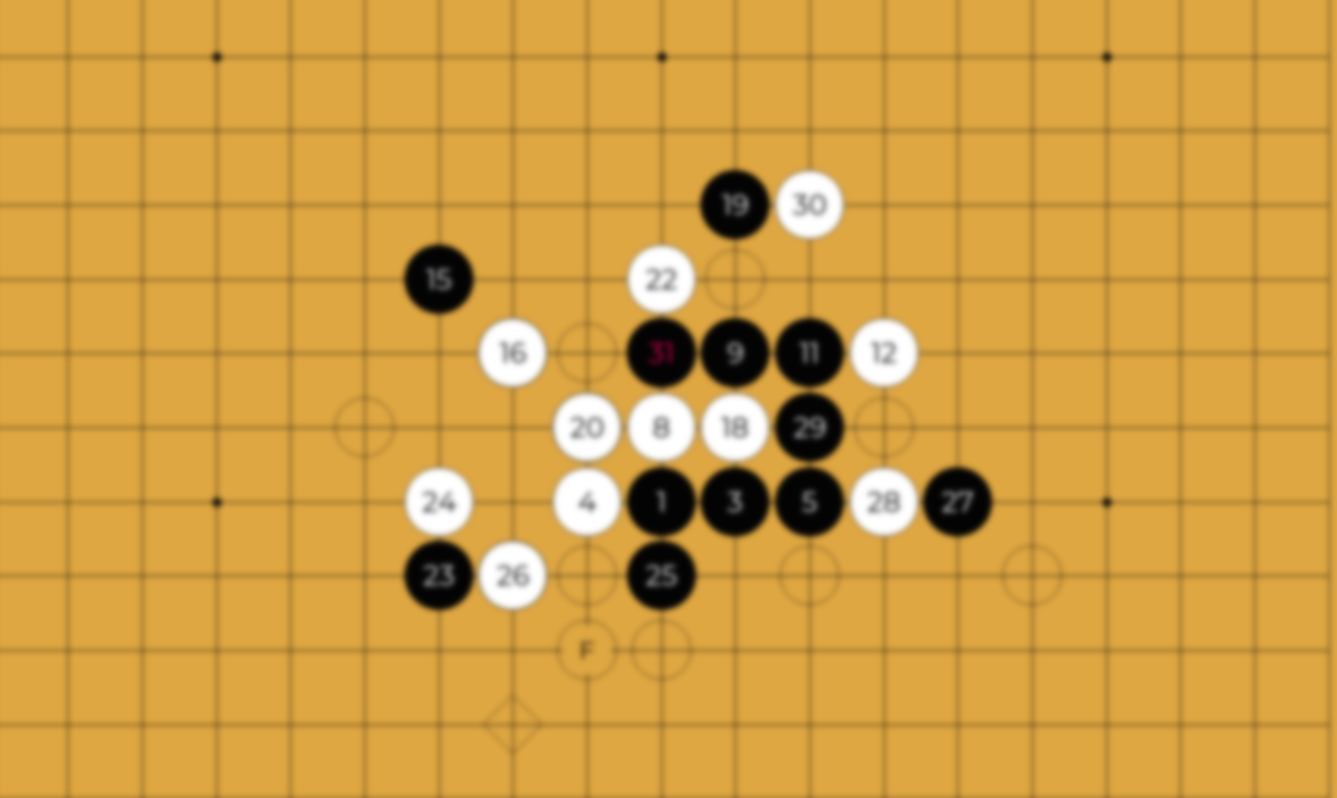
Mini Project 3 Gomoku AI
Due: 6/20 (Monday)

Slide 2
Outline
Introduction
Gomoku
State Value Function
Minimax
Alpha-Beta Pruning
How To Design Your AI
Package
Requirements
Grading

Slide 3
Outline
Introduction
Gomoku
State Value Function
Minimax
Alpha-Beta Pruning
How To Design Your AI
Package
Requirements
Grading

Slide 4
Introduction
Design and implement an AI that can play the boardgame Gomoku
Read the current board and output the next move
Design a state value function to evaluate the score of the board
Determine the next move with tree search algorithm

Slide 5
Outline
Introduction
Gomoku
State Value Function
Minimax
Alpha-Beta Pruning
How To Design Your AI
Package
Requirements
Grading

Slide 6
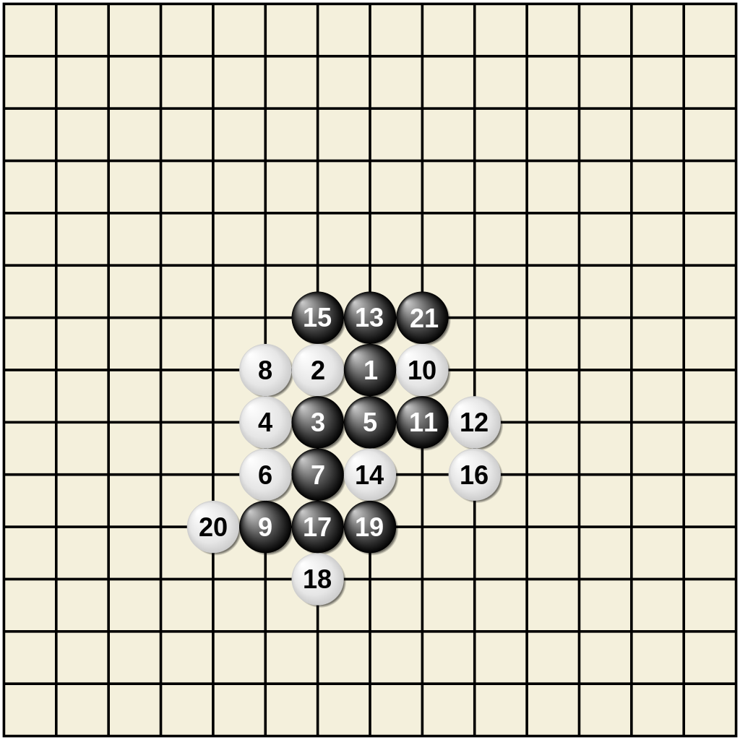
Gomoku (Five in a Row)
Source: https://en.wikipedia.org/wiki/Gomoku

Slide 7
Gomoku Rules
Use black and white discs and an 15 x 15 board, black plays first
Starts with initial empty board
Player can place disc at any empty intersection
The winner is the first player to form an unbroken chain of five stones (horizontally, vertically, or diagonally).

Slide 8
Outline
Introduction
Gomoku
State Value Function
Minimax
Alpha-Beta Pruning
How To Design Your AI
Package
Requirements
Grading

Slide 9
State Value Function
The program should decide which move is better
We can pick the move which leads to the board with highest score
Thus, we need a function to evaluate the score of the board
It is the “state value function”

Slide 10
State Value Function
State => the board
Value => how “good” the board is
Function => given a board, output the value

Slide 11
Simple Example
According to the Gomoku rule, we win if we have five in a row
Thus, we can define a simple value function:
Value = # of 3, 4 and 5 continuous player’s discs -# of 4 and 5 continuous opponent’s discs

Slide 12
Suppose we play as black, value = 8 – 0 = 8
Source: https://en.wikipedia.org/wiki/Gomoku

Slide 13
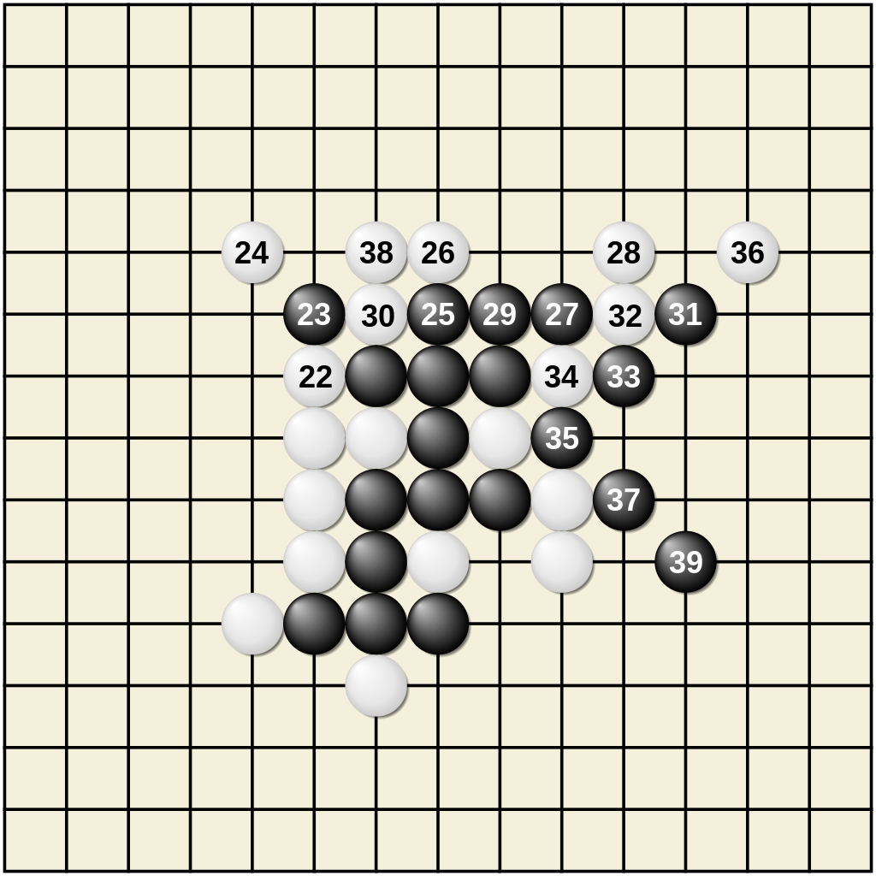
Another example, value = 11 – 1 = 10
Source: https://en.wikipedia.org/wiki/Gomoku

Slide 14
Use value function to pick the next move
Suppose we have three valid moves, A, B, and C:
Current
Move A
Move C
Move B
After
Move A
After
Move B
After
Move C

Slide 15
Use value function to pick the next move
After evaluating the state values, we have 20, -15, and 30
Current
Move A
Move C
Move B
Value
20
Value
-15
Value
30

Slide 16
Use value function to pick the next move
We pick move C to be our next step since it leads to the highest value
Current
Move A
Move C
Move B
Value
20
Value
-15
Value
30

Slide 17
Stronger Value Functions
The value function in the previous example is too simple
It is nearly impossible to beat the baselines by using it
In this mini project, you must design a stronger value function to evaluate how “good” the board is

Slide 18
Features You Can Utilize
Disc count
Valid move count
Disc position
Game status (win, lose)
Try to figure out more features by yourself

Slide 19
Outline
Introduction
Gomoku
State Value Function
Minimax
Alpha-Beta Pruning
How To Design Your AI
Package
Requirements
Grading

Slide 20
Minimax
In the previous example, we only look forward for one step
However, the opponent will try its best to defeat you
Greedy choice is not always the best
We should look forward for more steps and simulate how the opponent thinks to make the best choice with least risk

Slide 21
Minimax
Player tries its best to win
Player picks the move with the highest score
Opponent tries its best to defeat the player
Opponent picks the move with the lowest “player’s value function” score
That is, opponent tends to give the player the worst board
The Minimax algorithm is based on this player-opponent interaction

Slide 22
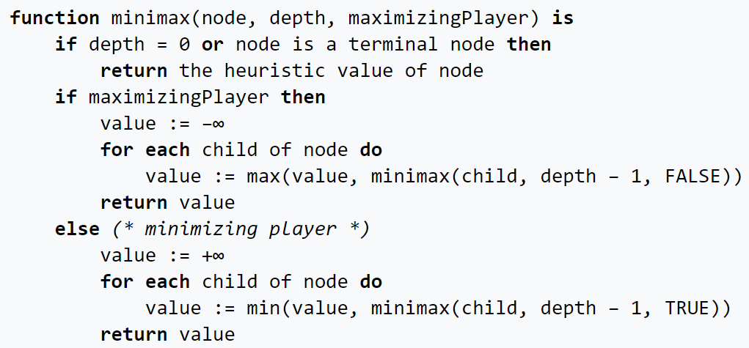
Minimax Pseudocode
Source: https://en.wikipedia.org/wiki/Minimax

Slide 23
Example
Now
:Player
:Opponent
A
B
C
D
E
F
G
H
I
J
K

Slide 24
Evaluate score at leaves
Now
:Player
:Opponent
A
B
C
D
E
F
G
H
I
J
K
5

Slide 25
Evaluate score at leaves
Now
:Player
:Opponent
A
B
C
D
E
F
G
H
I
J
K
5
6

Slide 26
Player picks the largest score
Now
:Player
:Opponent
A
B
C
D
E
6
F
G
H
I
J
K
5
6

Slide 27
Evaluate score at leaves
Now
:Player
:Opponent
A
B
C
D
E
6
F
G
H
I
J
K
5
6
7

Slide 28
Evaluate score at leaves
Now
:Player
:Opponent
A
B
C
D
E
6
F
G
H
I
J
K
5
6
7
4

Slide 29
Evaluate score at leaves
Now
:Player
:Opponent
A
B
C
D
E
6
F
G
H
I
J
K
5
6
7
4
5

Slide 30
Player picks the largest score
Now
:Player
:Opponent
A
B
C
D
E
6
7
F
G
H
I
J
K
5
6
7
4
5

Slide 31
Opponent picks the smallest score
Now
:Player
:Opponent
A
B
6
C
D
E
6
7
F
G
H
I
J
K
5
6
7
4
5

Slide 32
Evaluate score at leaves
Now
:Player
:Opponent
A
B
6
C
D
E
6
7
F
G
H
I
J
K
5
6
7
4
5
3

Slide 33
Player picks the largest score
Now
:Player
:Opponent
A
B
6
C
D
E
6
7
3
F
G
H
I
J
K
5
6
7
4
5
3

Slide 34
Opponent picks the smallest score
Now
:Player
:Opponent
A
B
6
3
C
D
E
6
7
3
F
G
H
I
J
K
5
6
7
4
5
3

Slide 35
Move A has the largest score
Now
:Player
:Opponent
A
B
6
3
C
D
E
6
7
3
F
G
H
I
J
K
5
6
7
4
5
3

Slide 36
Player picks move A to be the next move
Now
:Player
:Opponent
A
B
6
3
C
D
E
6
7
3
F
G
H
I
J
K
5
6
7
4
5
3

Slide 37
Outline
Introduction
Gomoku
State Value Function
Minimax
Alpha-Beta Pruning
How To Design Your AI
Package
Requirements
Grading

Slide 38
Alpha-Beta Pruning
By Minimax, we can simulate our opponent’s moves and pick a move with minimum risk and maximum value
Looking forward for more steps may improve the policy
However, the size of the search tree may drastically increase with the increase of search depth

Slide 39
Alpha-Beta Pruning
Since we only have limited time, if we hope to increase search depth, we must optimize the search process
There are many branches in the minimax process which is not related to the result
We can try to “prune” these branches to improve efficiency
The Alpha-Beta Pruning is the improved version of Minimax method which eliminates some unnecessary branches

Slide 40
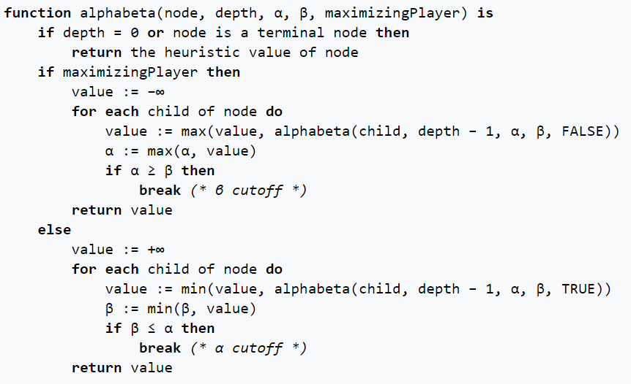
Alpha-Beta Pruning Pseudocode
Source: https://en.wikipedia.org/wiki/Alpha%E2%80%93beta_pruning

Slide 41
Alpha-Beta Pruning
Alpha: the maximum score that the player is assured of in the current search process
Beta: the minimum score that the opponent is assured of in the current search process

Slide 42
Alpha-Beta Pruning
If alpha >= beta on a player node, we can stop to search on this branch
In this situation, the player will return a value >= beta on this branch
However, the opponent already has a better choice (beta)
Thus, no matter the later discovered value on this branch, the opponent will not pick this branch
We can “prune” this branch since it will not affect the result
We can also stop to search if beta <= alpha on an opponent node

Slide 43
Example
Now
α: -INF
β: INF
:Player
:Opponent
A
B
α: -INF
β: INF
C
D
E
α: -INF
β: INF
F
G
H
I
J
K

Slide 44
Evaluate score at leaves
Now
α: -INF
β: INF
:Player
:Opponent
A
B
α: -INF
β: INF
C
D
E
α: -INF
β: INF
F
G
H
I
J
K
5

Slide 45
Update alpha
Now
α: -INF
β: INF
:Player
:Opponent
A
B
α: -INF
β: INF
C
D
E
α: 5
β: INF
F
G
H
I
J
K
5

Slide 46
Evaluate score at leaves
Now
α: -INF
β: INF
:Player
:Opponent
A
B
α: -INF
β: INF
C
D
E
α: 5
β: INF
F
G
H
I
J
K
5
6

Slide 47
Update alpha
Now
α: -INF
β: INF
:Player
:Opponent
A
B
α: -INF
β: INF
C
D
E
α: 6
β: INF
F
G
H
I
J
K
5
6

Slide 48
Player picks the largest score
Now
α: -INF
β: INF
:Player
:Opponent
A
B
α: -INF
β: INF
C
D
E
6
α: 6
β: INF
F
G
H
I
J
K
5
6

Slide 49
Update beta
Now
α: -INF
β: INF
:Player
:Opponent
A
B
α: -INF
β: 6
C
D
E
6
α: 6
β: INF
F
G
H
I
J
K
5
6

Slide 50
Propagate alpha and beta values
Now
α: -INF
β: INF
:Player
:Opponent
A
B
α: -INF
β: 6
C
D
E
6
α: 6
β: INF
α: -INF
β: 6
F
G
H
I
J
K
5
6

Slide 51
Evaluate score at leaves
Now
α: -INF
β: INF
:Player
:Opponent
A
B
α: -INF
β: 6
C
D
E
6
α: 6
β: INF
α: -INF
β: 6
F
G
H
I
J
K
5
6
7

Slide 52
Update alpha
Now
α: -INF
β: INF
:Player
:Opponent
A
B
α: -INF
β: 6
C
D
E
6
α: 6
β: INF
α: 7
β: 6
F
G
H
I
J
K
5
6
7

Slide 53
Alpha >= beta in a player node, stop searching
Now
α: -INF
β: INF
:Player
:Opponent
A
B
α: -INF
β: 6
C
D
E
6
α: 6
β: INF
7
α: 7
β: 6
F
G
H
I
J
K
5
6
7

Slide 54
Opponent picks the smallest score
Now
α: -INF
β: INF
:Player
:Opponent
A
B
6
α: -INF
β: 6
C
D
E
6
α: 6
β: INF
7
α: 7
β: 6
F
G
H
I
J
K
5
6
7

Slide 55
Alpha-Beta Pruning
In the example above, we use the same search tree as Minimax
By pruning, we eliminate branches I and J
However, we still get the same result on branch A
Alpha-Beta Pruning can effectively speed up the process while maintaining the same result

Slide 56
Outline
Introduction
Gomoku
State Value Function
Minimax
Alpha-Beta Pruning
How To Design Your AI
Package
Requirements
Grading

Slide 57
How To Design Your AI
The game runner (main.cpp) executes the AIs of the player and the opponent in turns and communicates with them by files
Your game AI should read the board status from the file “state”
Your game AI should output your move to the file “action”

Slide 58
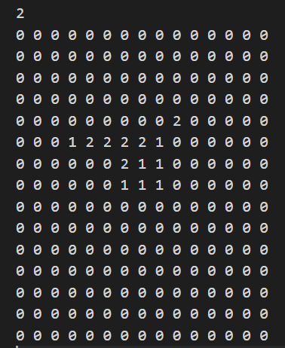
State file
The state file consists of four parts:
Current player (1 or 2)
Board (15 x 15 matrix)

Slide 59

Action file
Your AI should output the next move to the “action” file
You can keep output moves in the time limit
Only the last complete output will be considered
In the case on the right, (3, 5) will be accepted by the game runner
You lose if you outputs an invalid move

Slide 60
How To Design Your AI
You can refer to the “player_random.cpp” in the “src” folder of the package we provided
Design your state value function to evaluate the board
Implement the Alpha-Beta Pruning method and use your value function in the search process
Run Alpha-Beta Pruning and decide which move to output

Slide 61
Outline
Introduction
Gomoku
State Value Function
Minimax
Alpha-Beta Pruning
How To Design Your AI
Package
Requirements
Grading

Slide 62
Package Directory Structure
Mini Project 3
baseline
windows
baseline<i>.exe, i := {1, 2}
linux
baseline<i>, i := {1, 2}
mac
baseline<i>, i := {1, 2}
src
main.cpp
makefile
player_random.cpp
documents
Mini Project 3 Spec.pdf
Mini Project 3 Introduction.pptx
Mini Project 3 Environment Settings.pptx
Mini Project 3 WSL Installation Tutorial New.pptx

Slide 63
Baseline
The baseline folder contains executables of the baselines
If you use Windows, use the baselines in the windows folder
If you use Linux, use the baselines in the linux folder
If you use Mac, use the baselines in the mac folder
We have three hidden baselines and these open baselines to test the performance of your program
Test your program against the open baselines and try to defeat them

Slide 64
Baseline
baseline0 => pure random
baseline1 => minimax with basic value function
baseline2 => deeper minimax with basic value function
baseline3 => alpha beta pruning with basic value function
Baseline4 => deeper alpha beta pruning with basic value function

Slide 65
Src
The src folder contains the main program, a makefile and some provided example programs
The main.cpp is the game runner, do not modify it
However, you can refer to it when implementing game simulation of minimax
The makefile helps you compile your code
You can also compile by hand, make sure you set the flags -Wall and –Wextra
player_random.cpp => the pure random AI
You can refer to this one and write your own code

Slide 66
How To Compile Your Code
To compile all programs:
Type make when your working directory is ‘src’
To compile <program_name>.cpp:
Type make <program_name> when your working directory is ‘src’
To clean the executables:
Type make clean when your working directory is ‘src’

Slide 67
How To Test Your Code
If you use Windows, type the command below in cmd:
main.exe <AI1>.exe <AI2>.exe
If you use Linux / Max, type the command below in terminal:
./main ./<AI1> ./<AI2>

Slide 68
Outline
Introduction
Gomoku
State Value Function
Minimax
Alpha-Beta Pruning
How To Design Your AI
Package
Requirements
Grading

Slide 69
Requirements - Code
Design and implement an AI that can play the boardgame Gomoku
Your AI should read the board from file and write next move to file
Design a value function to evaluate the score of the board
Enhance the policy of your AI with Alpha-Beta Pruning

Slide 70
Requirements - Code
If you are not satisfied by the Alpha-Beta Pruning algorithm, you can try some more advanced methods. However, make sure you can explain how Minimax and Alpha-Beta Pruning works during demo
If you cannot complete the Alpha-Beta Pruning algorithm, implementing the basic Minimax algorithm also gives you some score

Slide 71
Requirements - Code
You will lose immediately if your program outputs an invalid move
Time limit for each move is 10 seconds, and the memory limit is 4GB
You can keep output moves in the limited time. Only the last successful output move is used by the game runner
Please refer to the spec for more detailed rules

Slide 72
Requirements - Submission
Please use C++ and write your program in a single file
Your program should be named as <student_id>_project3.cpp
Your program will be compiled in a GNU / Linux environment by:
g++ -O2 -std=c++14 -Wall -Wextra <student_id>_project3.cpp
Please make sure your program can be compiled by the command above with no error

Slide 73
Requirements - Report and Demo
You should write a report to elaborate on how you design your AI
The report is not directly graded, but is your only available reference through the TA demo (You cannot refer to your code in demo)
You must attend the demo and answer the questions from TA
The demo date and method will be announced soon

Slide 74
Outline
Introduction
Gomoku
State Value Function
Minimax
Alpha-Beta Pruning
How To Design Your AI
Package
Requirements
Grading

Slide 75
Grading
The project accounts for 9 points of your total grade
Beat every baseline => +5 points (1 point for each baseline) (Win First Hand and Second Hand)
Implement Tree search (Minimax) => +2 points
Design of your state value function => +1 point
Implement Alpha-Beta Pruning => +1 point

Slide 76
Grading Bonus
(Bonus) Uses version control software => +1 point
Include a screenshot with more than 3 commits in your report
(Bonus) Class ranking => At most +2 points
You can attend the class ranking if you beat all baselines
Your AI will play against other AIs of your classmates and gain bonus score according to your ranking

Slide 77
Happy Coding!

